Slide 1

ANDHRA LOYOLA INSTITUTE OF ENGINEERING AND TECHNOLOGY
DEPARTMENT OF ELECTRONICS AND COMMUNICATION ENGINEERING
SEMINAR TOPIC: ADVANCED HEARING AID DATE:19-06 -2021
PRESENTED BY: KODALI SATWIK
17HP1A04B3.

Slide 2
Contents:
Introduction
Diagram of hearing system
What is a hearing aid
Block diagram
Components of hearing aid
Working of hearing aid
Types of hearing aid
Advanced hearing aid-A Smart Binaural Hearing Aid Architecture Based on
a Mobile Computing Platform.
Proposed architecture of hearing aid
Architectural level of comparison of hearing aid
Applications
Conclusion
References

Slide 3
INTRODUCTION:
Hearing loss that’s due to problems with the ear canal, eardrum, or middle ear is called conductive hearing loss. Most of the time, surgery or other medical help can make it better. But those options aren’t right for everyone. If you have an open ear canal and a relatively normal external ear, a hearing aid may help.
Some people are born without an external ear or ear canal, which means they can’t use a typical hearing aid. Instead, they may be able to use a device that sends sound to the inner ear through the bone of their skull.
Early devices, such as ear trumpets or ear horns were passive amplification cones designed to gather sound energy and direct it into the ear canal. Modern devices are computerised electroacoustic systems that transform environmental sound to make it audible, according to audiometrical and cognitive rules.

Slide 4
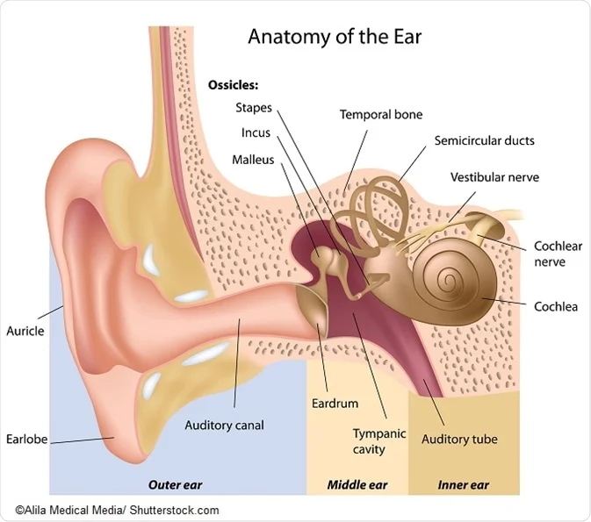
Diagram of hearing system:

Slide 5
WHAT IS A HEARING AID?
A Hearing Aid is an electronic, battery- operated device that amplifies and changes sound to allow for improved communication
A hearing aid is a device designed to improve hearing by making sound audible to a person with hearing loss. Hearing aids are classified as medical devices in most countries, and regulated by the respective regulations. Small audio amplifiers such as other plain sound reinforcing systems cannot be sold as "hearing aids".

Slide 7
Block diagram:

Slide 8
COMPONENTS OF HEARING AID:
To understand how hearing aids work, let’s take a look inside a typical hearing aid. All hearing aids include five basic components:
Microphone
Amplifier
Battery
Receiver

Slide 9
Microphone:
The hearing aid microphone is the start of the process to help you hear better. The microphone picks up the different sounds in your environment and converts them to electric signals that can be understood by the processor.
Microphones are now able to differentiate sounds, such as speech and background noise, and process them differently for a much more seamless hearing experience than in the past.
There are two types of microphones: directional and omnidirectional.
Directional microphones pick up mostly sounds in front of the wearer. This can be helpful when trying to understand a conversation in a noisy environment.
Omnidirectional microphones pick up sounds from all directions, helping to give the user a better sense of where sounds are coming from. Most new hearing aids come equipped with both types of microphones to help wearers pick up speech from multiple directions, creating a more natural listening experience.

Slide 10
Amplifier:
It takes the electric signals received from the microphone and converts them into digital signals that can be manipulated.
It's during this step that the sound, now a digital signal, is adjusted to the wearer's requirements, including how much the signal needs to be amplified to effectively accommodate the person's hearing loss. Any feedback or noise from wind is cancelled or reduced. This is also where any tinnitus masking features would be added.
Once all of the approapriate adjustments have been made to the digital signal, the processor then converts it back to an analog signal. It's here when the signal is sent to the third and final hearing aid component.

Slide 11
Battery:
While there are some instances that a hearing aid uses a rechargeable battery or a long-life disposable battery, the majority of modern hearing aids use one of five standard button cell zinc–air batteries.
Older hearing aids often used mercury battery cells, but these cells have become banned in most countries today.
Modern hearing aid button cell types are typically referred to by their common number name or the color of their packaging.
They are typically loaded into the hearing aid via a rotating battery door, with the flat side (case) as the positive terminal (cathode) and the rounded side as the negative terminal (anode).
These batteries all operate from 1.35 to 1.45 volts.
The type of battery a specific hearing aid utilizes depends on the physical size allowable and the desired lifetime of the battery, which is in turn determined by the power draw of the hearing aid device. Typical battery lifetimes run between 1 to 14 days (assuming 16-hour days)

Slide 12
Receiver:
The receiver converts the amplified electrical signal into sound and delivers it into the ear without distorting or limiting the sound.
The final component in the process is the receiver. It creates an enhanced soundwave that will meet the hearing loss needs of its wearer. In order for this to happen, the receiver must convert the signal sent from the processor to audible sounds and output it to the wearer's ears.
The receiver is the piece of the device directed at the wearer's inner ear. Some hearing aids have the receiver placed directly in the ear canal, such as with a completely-in-the-canal style. Other devices have the receiver connect to a small tube that's inserted into the ear, like with the behind-the-ear style.

Slide 13
How a hearing aid works: step-by-step:
1. Microphones pick up nearby sounds
2. Sounds are analyzed and adjusted by the processing chip customized to your type of hearing loss
3. Processed sounds are sent to the amplifier
4. Amplified sounds are sent to the speaker
5. Sounds are transmitted by the speaker into the inner ear, via tubing in an ear mold in the ear canal, or via a thin wire to a receiver in the ear
6. In the inner ear, sounds are transformed into electrical impulses
7. Electrical impulses are picked up by the brain, where they are processed into sound

Slide 14
TYPES OF HEARING AID:
There are two basic types of hearing aids:
In-the-ear(ITE) Hearing Aids
Behind-the-ear (BTE) hearing aids
In-the-ear(ITE) Hearing aids are of four types:
Invisible in the canal (IIC) Hearing Aids
Completely in the canal (CIC) Hearing Aids
In-the-canal (ITC) hearing aids
Low-profile hearing aids
Behind-the-ear (BTE) Hearing aids are of two types:
Receiver in the ear (RITE) Hearing Aids
Behind-the-ear with earmold Hearing Aids

Slide 15
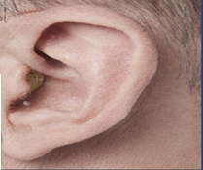
In-the-ear (ITE) hearing aids:
ITE aids are worn in the ear canal and are usually custom-fit, based on an impression that is taken by your hearing care professional at the time of your hearing aid consultation.
These styles are typically available in different skin tones to blend with the outer ear. Some types of ITE hearing aids fit very deeply within the ear canal, while others are closer to the outer ear.

Slide 16
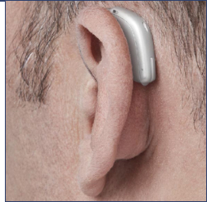
Behind-the-ear (BTE) hearing aids:
BTE aids sit behind or on top of the outer ear with tubing that routes the sound down into the ear canal via a custom-fit earmold or a dome style that doesn’t block the entire ear canal opening. BTE styles are available in different colors to match hair or skin tone, as well as flashier designs for personalized flair.
For either ITE or BTE, most devices come with standard button batteries that must be replaced anywhere from 3-20 days. However, rechargeable batteries are becoming more common.

Slide 17
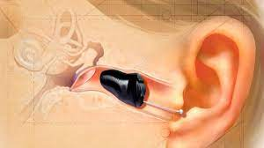
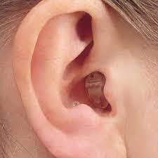
Invisible in the canal (IIC)&Completely in the canal (CIC):
IIC and CIC styles are the smallest and most discreet hearing aids available. "Invisible in the canal" IIC styles are as described—virtually invisible. A wearer places them very deeply in the ears, and they must be removed by tugging on a small pull-out string. "Completely in the canal" CIC are very similar, but don't sit quite so deeply within the ears.
These styles are typically fit for people with mild to moderate hearing loss. Because of their small size, they don’t usually come with any manual controls, like volume wheels or program buttons.

Slide 18
Advantages:
good sound quality because of how they fit within the ear.
Disadvantages:
susceptible to ear wax and moisture damage.
small size also can be a problem for connectivity to wireless devices, like smartphones.

Slide 19
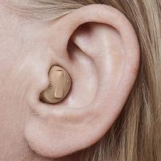
In-the-canal (ITC) hearing aids:
ITC hearing aids sit in the lower portion of the outer ear bowl, making them comfortable and easy to use. Because they’re slightly larger than IIC and CIC styles, they tend to have a slightly longer battery life and can fit a wider range of hearing losses. Their size also allows them to host additional features such as directional microphones for better understanding in noisy environments and manual controls, like a volume wheel, if desired.

Slide 20
Advantages:
longer battery life and more features than IIC and CIC styles.
Disadvantages:
susceptible to ear wax and moisture damage.
small size can be a problem for connectivity to wireless devices.

Slide 21
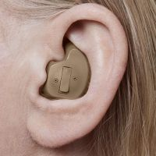
Low-profile hearing aids:
Low-profile hearing aids are similar to ITC styles, and range from half-shell designs that fill half the bowl of the outer ear to full-shell designs that fill almost the entire outer ear bowl. Like ITC styles, low-profile designs are large enough to feature directional microphones and manual controls, such as a volume wheel and a push-button for changing programs. The size of a low-profile style makes it desirable for people with dexterity issues because it is easier to handle than the smaller sizes.

Slide 22
Advantages:
larger size easier to insert and remove.
accommodates more features and user controls.
likely to have connectivity to wireless devices like phones.
Disadvantages:
less discreet than smaller in-the-ear styles.
more occlusion, can make wearers feel plugged up.

Slide 23
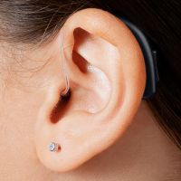
Receiver in the ear (RITE):
This style is typically known as either as "receiver in the ear" (RITE) or "receiver in canal" (RIC), depending on the manufacturer. But they essentially mean the same thing—an open-fit hearing aid style that has the speaker built into an insertable ear dome, instead of the main body of the hearing aid. In other words, the speaker of the hearing aid rests in the ear canal, but the microphone and processor sit in a tiny case behind the ear. They are connected by a thin wire. This style of hearing aid tends to have above-average sound quality and is made by all major hearing aid manufacturers.
If it gets damaged, the speaker portion of the hearing aid that fits in the ear can often be replaced at the hearing aid center, instead of having to be shipped off to the manufacturer for repair.

Slide 24
Advantages:
generally the only style that comes with a rechargeable batteries option.
most likely to come with wireless connectivity to devices like phones.
the speaker can be replaced separately.
Disadvantages:
smaller RITE sizes can be a problem for dexterity.
speaker, which is inside the ear, is susceptible to moisture and ear wax damage.
the microphone and sound processor that sit behind the ear is visible.

Slide 25
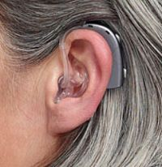
Behind-the-ear with earmold:
BTE styles that come with earmolds can fit any type of hearing loss, from mild to profound. Their longer shape follows the contour behind the outer ear and can generally house more features, controls and battery power than any other style of hearing aid. A BTE with earmold style is commonly used for children because the BTE can be reprogrammed as needed and the earmold can be replaced as the child grows.

Slide 26
Advantages:
fits all degrees of hearing loss, including profound hearing loss.
usually available in models with wireless connectivity to devices.
custom-fit earmold can be replaced separately.
less susceptible to moisture damage.
Disadvantages:
more occlusion, can make wearers feel plugged up.
potential space limitations for eyeglass wearers.

Slide 27
A Smart Binaural Hearing Aid Architecture Based on
a Mobile Computing Platform:
Abstract:
This paper presents a new structure for hearing aids. Normally, the power consumption and
user experience are contradictory. The proposed hearing aid structure mainly consists of three parts:
the earpieces, the mobile computing platform, and the real-time speech-enhancement application.
It can run complex algorithms without carrying out heavy calculations on the processors in the
hearing aid. Thus, the binaural algorithm is utilized without being limited by complexity and power
consumption to improve the user experience. Moreover, the speech-enhancement algorithm can be
updated much more easily than in traditional built-in digital signal process hearing aids. A good
level of user experience is achieved by combining the hearing aid and mobile computing platform
with a 400-MHz transceiver; furthermore, the 400-MHz transceiver can reduce path loss around the
body. The concept verification process showed that the overall usage of the central processing unit
in the smartphone is around 16%, the signal-to-noise ratios show at least a 30% improvement in
some environments, and the whole system delay is 8.8 ms

Slide 28
The Proposed Architecture of HA:

Slide 29
Circuit Blocks:
Wireless Transceiver
Digital Acoustic Baseband Processor
Battery and Power Management
Real-Time Software

Slide 30
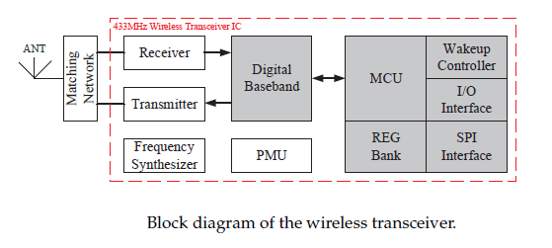
Wireless Transceiver:

Slide 31
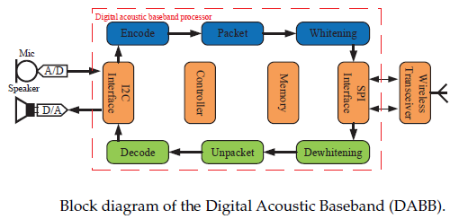
Digital Acoustic Baseband Processor:

Slide 32
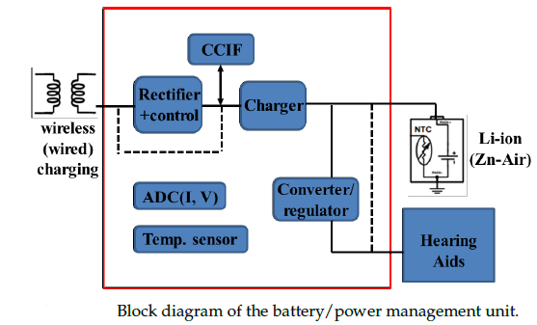
Battery and Power Management:

Slide 33
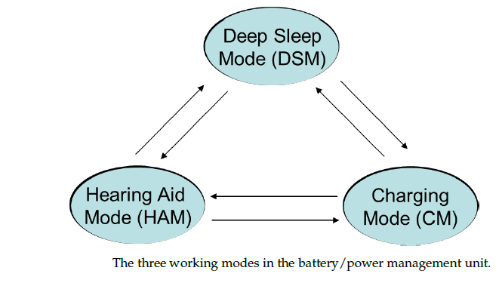

Slide 34
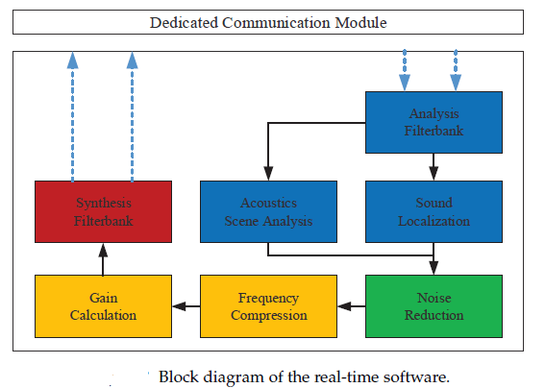
Real-Time Software:

Slide 35
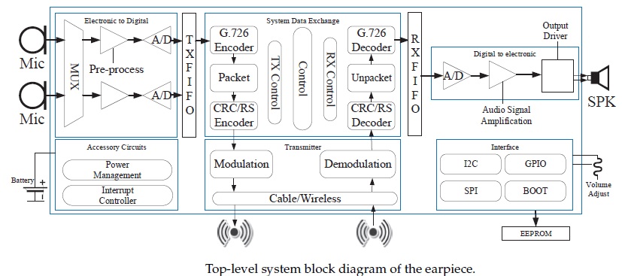
Hardware Implementation:

Slide 36
The Signal Data Exchange
The Packet Definition
Transmit Processing
Receive Processing
The Operating Scheme
Packet Exchange

Slide 37
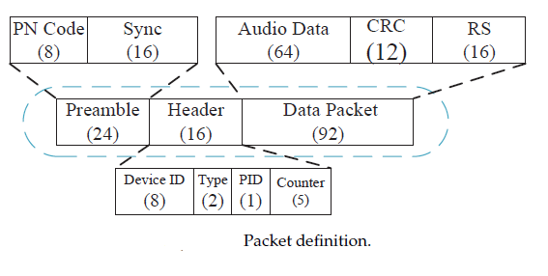
The Packet Definition:

Slide 38
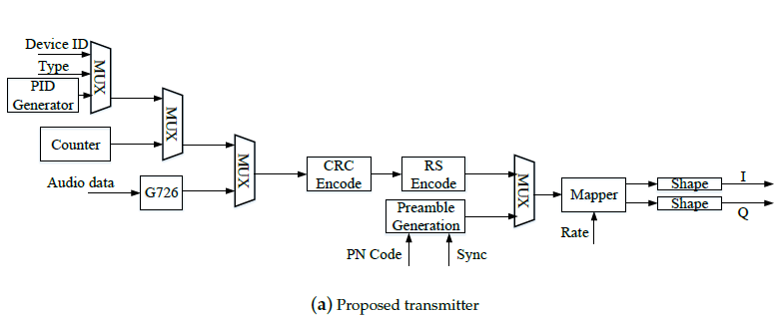
Transmit Processing:

Slide 39
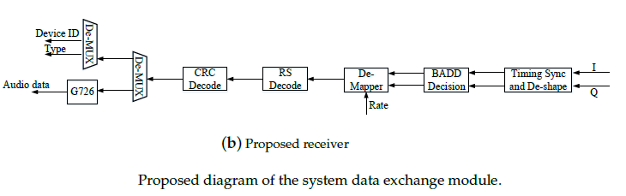
Receive Processing:

Slide 40
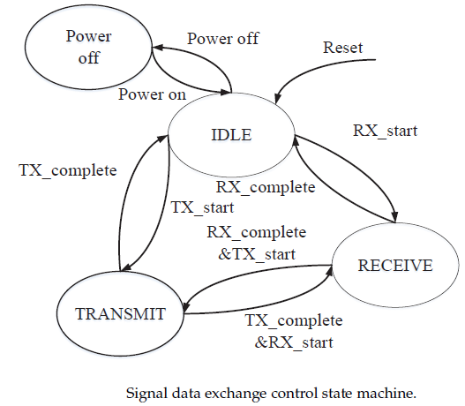
The Operating Scheme:

Slide 41
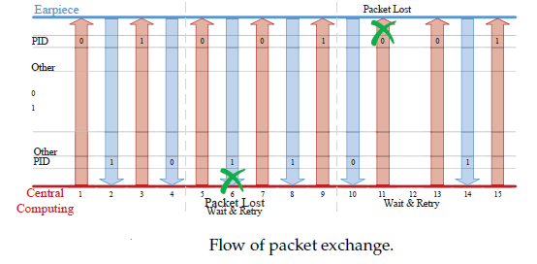
Packet Exchange:

Slide 42
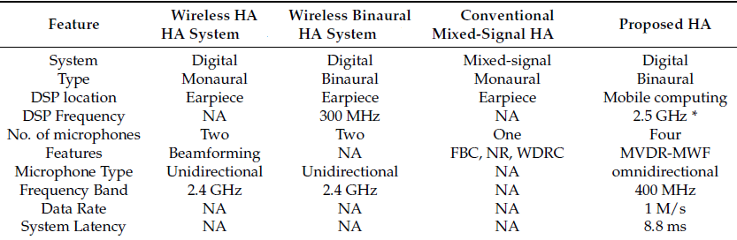
Architectural level comparison of hearing aids:

Slide 43
Applications:
the large distance between the microphone and the speaker prevents the occurrence of acoustic feedback
possibility to implement more convenient application control functions for people with poor motor skills
using of various types of headphones and headsets
it is possible to achieve the highest sound pressure level and get high sound quality (due to large speakers and a long battery life)
resistant to ingress of earwax and moisture;
it is possible to use more complex audio signal processing algorithms and a higher sampling rate (because of capacious battery)
software flexibility

Slide 44
Conclusion:
We developed a smart binaural HA structure based on an MCP. Compared to the traditional algorithms, the proposed architecture can design more complex algorithms without being limited by power consumption and complexity, thereby enhancing speech intelligibility.
Through designing advanced speech algorithms and accessible applications, there is a great potential for customized HA.
Removing built-in processors and combining HA with MCPs led to these advances. Objective data analysis and theoretical analysis showed an improvement in the user experience. These test results will arouse the interest of HA designers.

Slide 45
References:
WHO. Deafness and Hearing Loss. Available online: https://www.who.int/en/news-room/fact-sheets/detail/deafness-and-hearing-loss (accessed on 20 March 2019).
Widex. So How Do Hearing Aids Work? Available online: https://global.widex.com/en/hearing-aids(accessed on 1 January 2019)…
Staff, M.C. Hearing Aids: How to Choose the Right One. Available online: https://www.mayoclinic.org/diseases-conditions/hearing-loss/in-depth/hearing-aids/art-20044116 (accessed on 17 April 2019).
"Tinnitus And Hearing Aids - Optimal Hearing Systems,The Hearing Aid Company - Since 1961“.Optimal Hearing. 30 December 2016. Retrieved 5 July 2020.

Slide 46
THANK YOU

